Slide 1

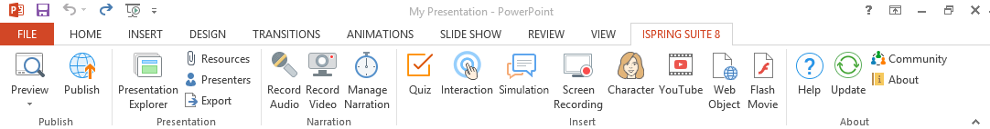
iSpring Suite 8
2-minute overview
To start, click Preview
under the iSpring Suite 8 tab

Slide 2

iSpring Suite 8
E-Learning Authoring Supercharger

Slide 3

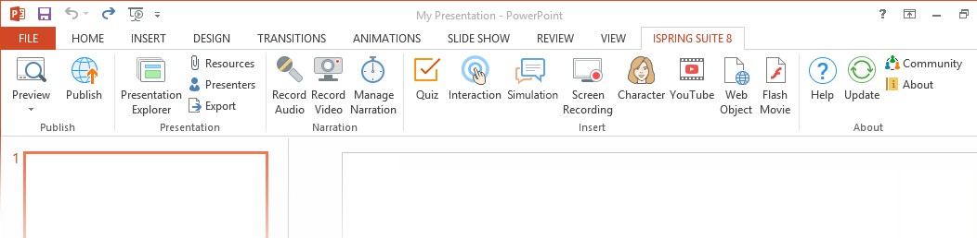
Getting Started
1
iSpring Suite 8 is a PowerPoint Add-In
Open an existing PowerPoint presentation or create a new one
To start, switch to the iSpring Suite 8 tab

Slide 4






Create Your Course in PowerPoint
2
iSpring Suite 8 accurately preserves virtually all PowerPoint elements:
Fonts &
Styles
Fonts & Styles
Shapes
Pictures
Audio & Video
Animations
Triggers
Hyperlinks
Transition Effects

Slide 5
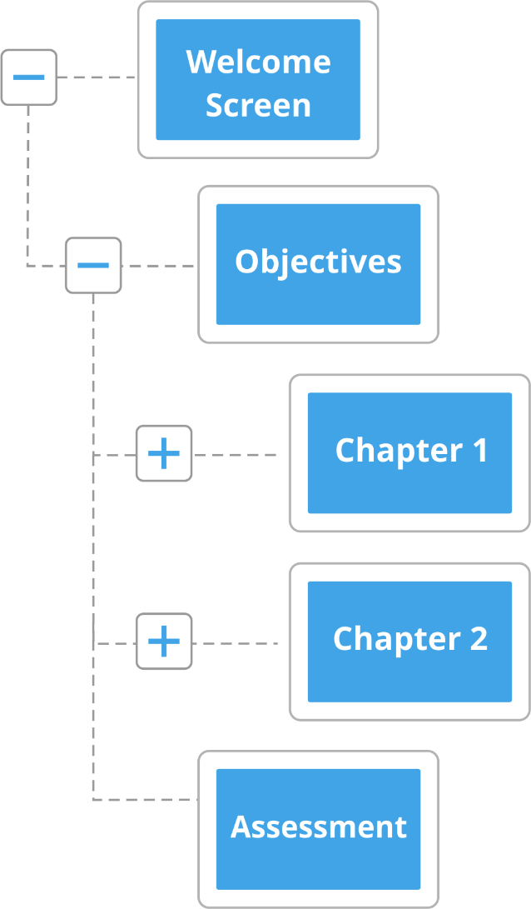
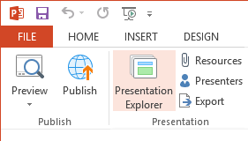
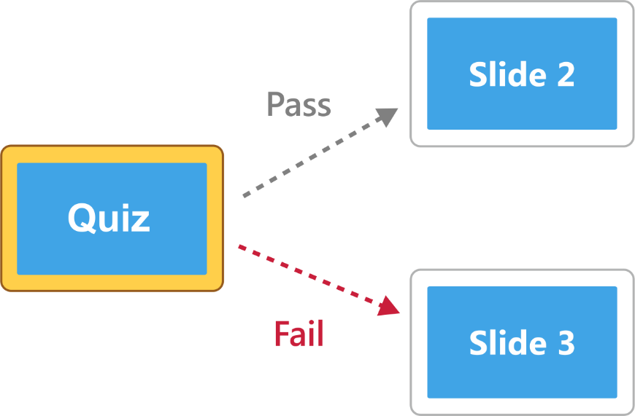
Set Up Course Structure
3
Create a hierarchical outline
Use branching scenarios

Slide 6
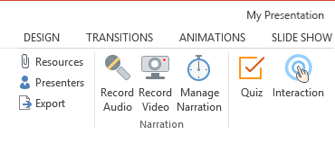
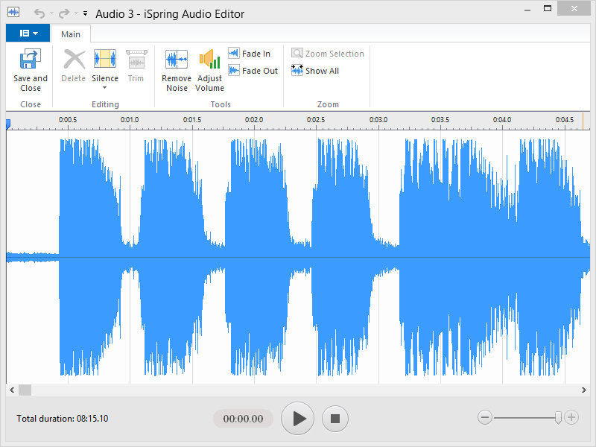
Add Audio and Video Narrations
4
Record/import and edit a voice-over or a presenter video and sync it with slides and animations.

Slide 7
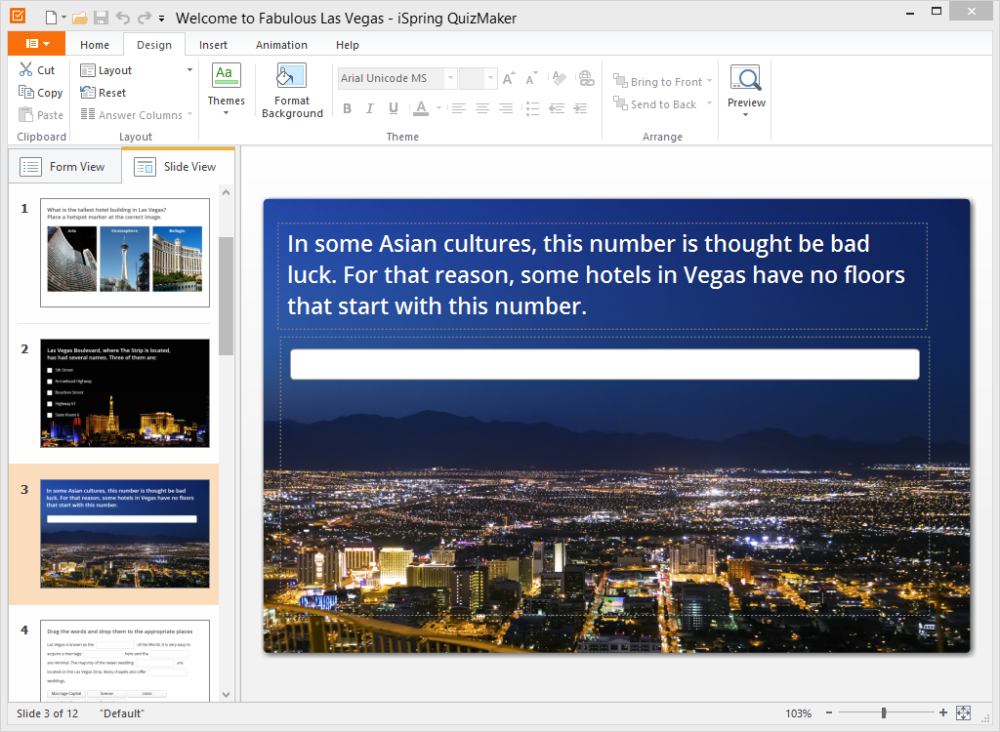
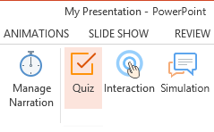
Create Customizable Quizzes and Surveys
5
23 types of questions, including drag-and-drops
Advanced branching scenarios
Convenient visual slide
editing mode
Flexible scoring system

Slide 8
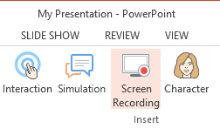
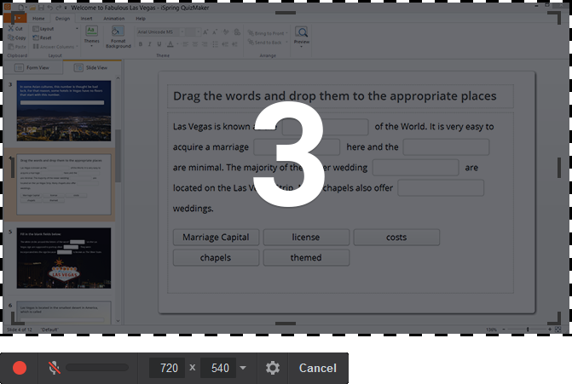
Make a Screen Recording
6
Record all or part of your screen, or an application
Record sound and add cursor highlighting
Instantly edit and save your video to MP4
Insert in your course or upload directly to YouTube

Slide 9
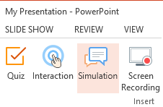
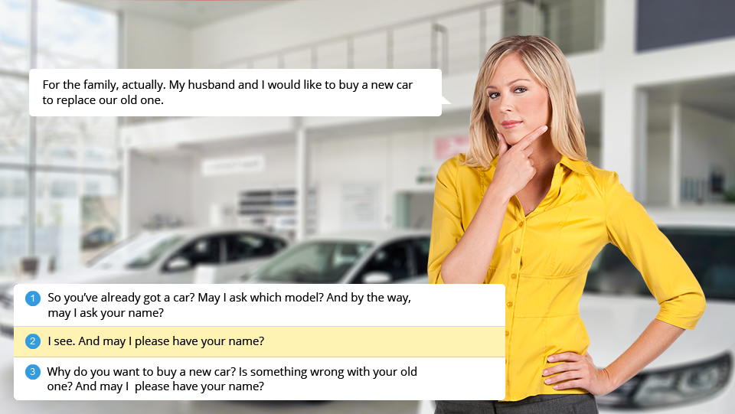
Create Conversation Simulations
7
Build scenes with conversation
and answer choices
Choose a character and background from the library
Guide users with character emotions
Award points for correct responses

Slide 10
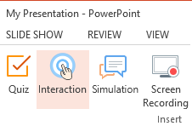
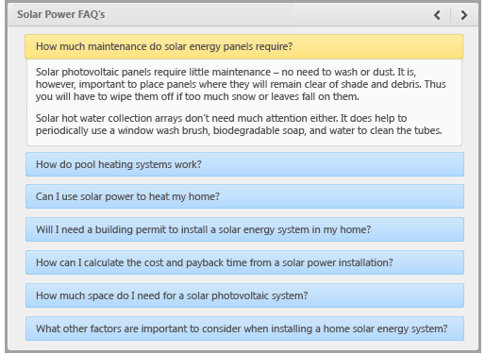
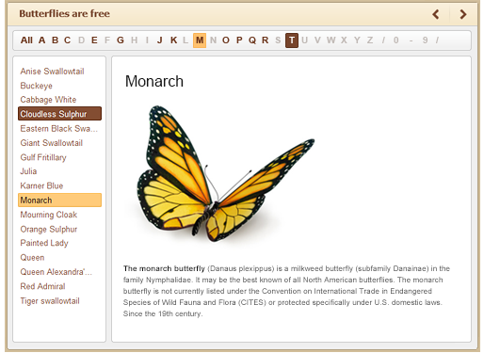
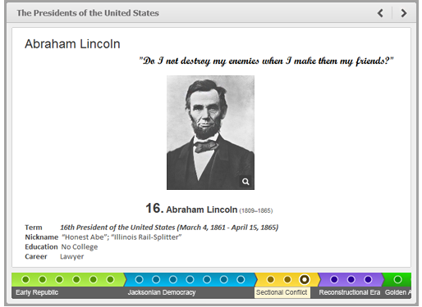

Use Spectacular Interactions
8
Book
Timeline
Directory
FAQ

Slide 11
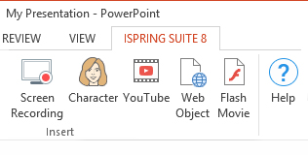
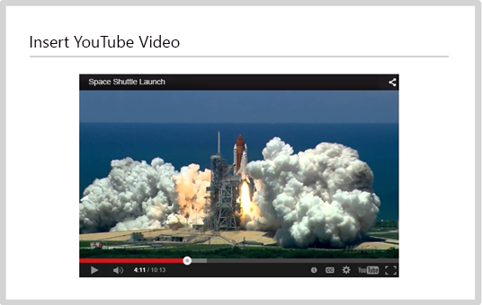


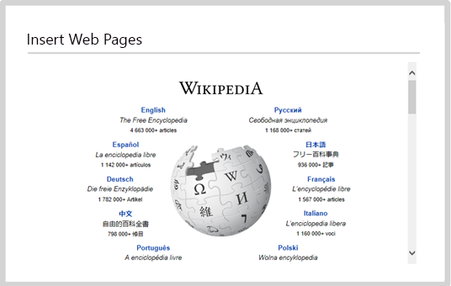
Saturate Your Course with Rich Media
9
Characters
YouTube Videos
Web Objects
Flash Movies

Slide 12
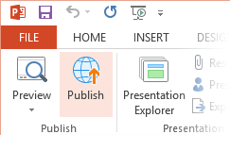
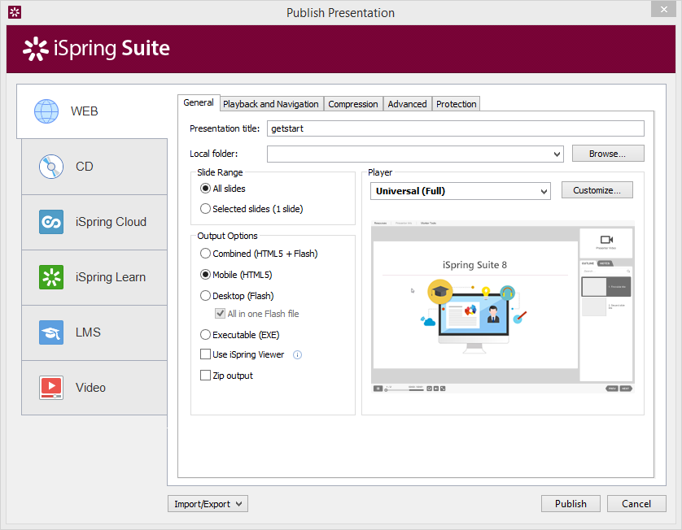
Publish Your Content Fast and Easy
10
More ways to reach more learners:
Web (Desktop, Mobile, Combined)
Learning Management System (SCORM, AICC, xAPI, Blackboard)
iSpring Learn LMS
iSpring Cloud hosting and sharing service
Video or direct-to-YouTube

Slide 13
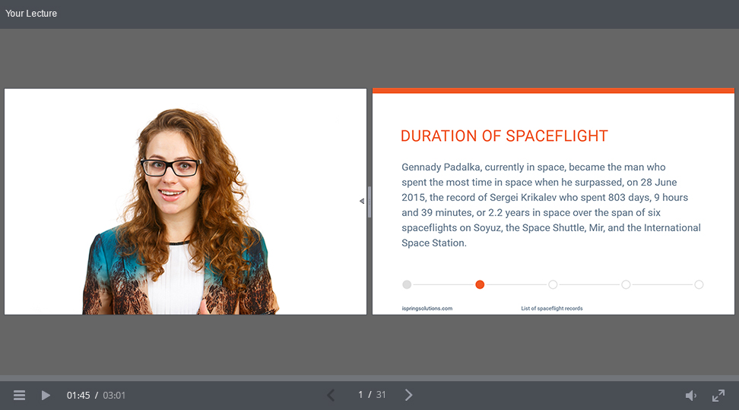
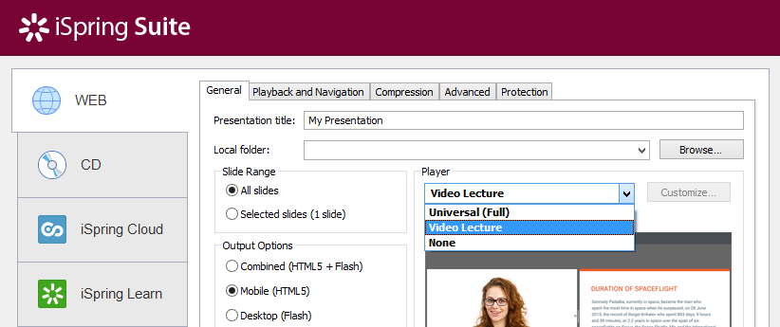
Use the Video Lecture Player for Fluid Layout
11
Choose the Video Lecture Player from the drop-down list.
Adjust the ratio between slides and presenter video when viewing a presentation.

Slide 14
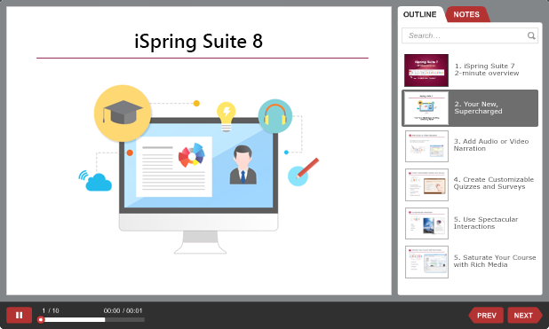
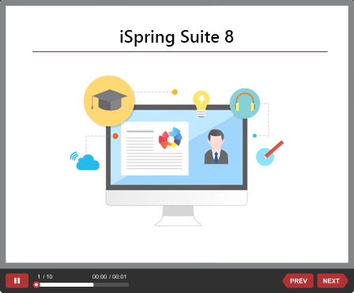
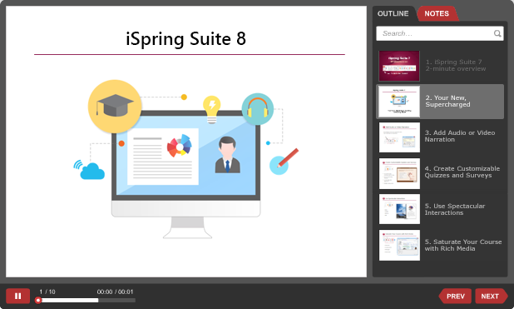
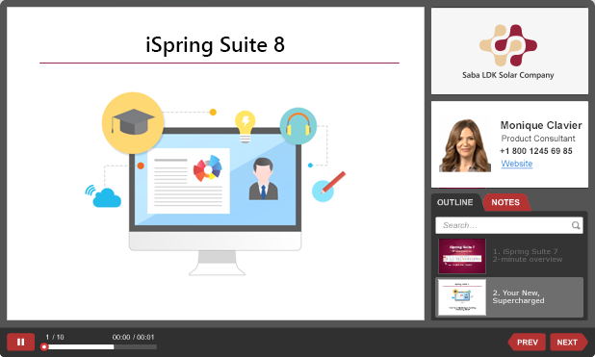
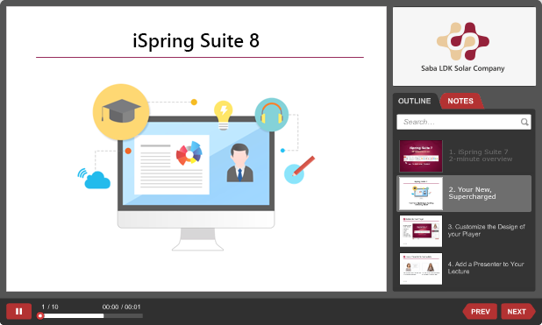
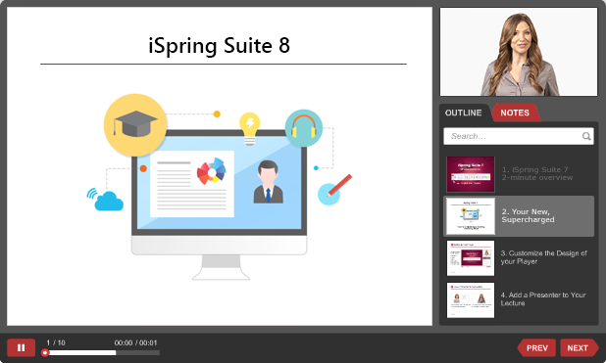
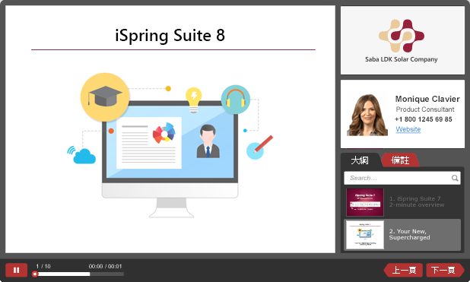
Customize the Universal Player
12
Templates
Layout
Colors
Presenter Video
Company Logo
Presenter Info
Text Labels

Slide 15
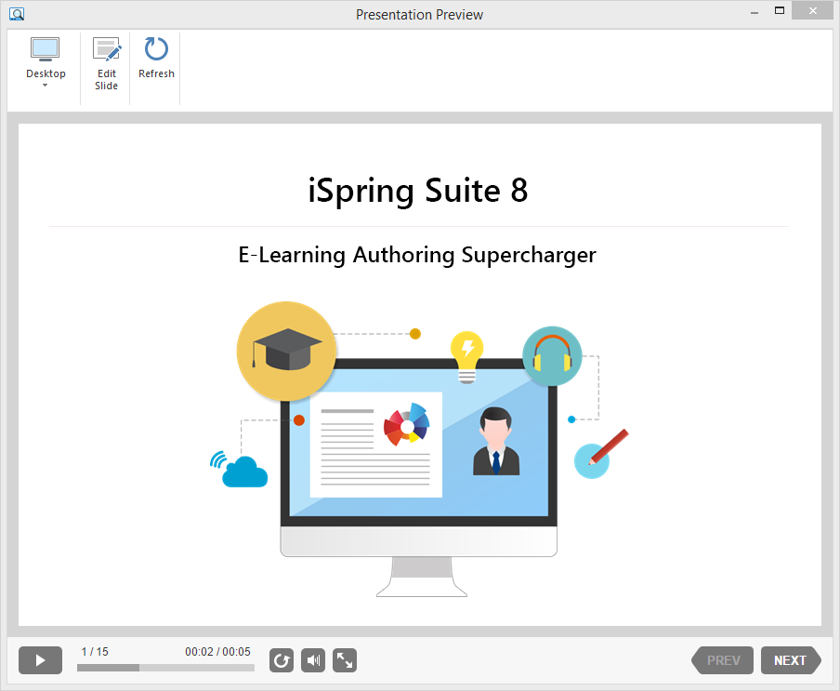
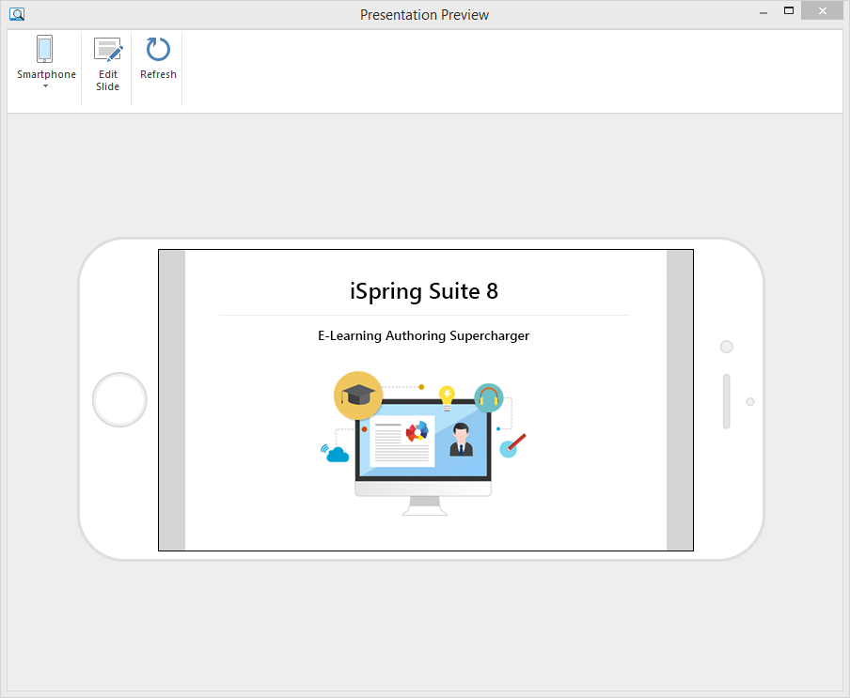
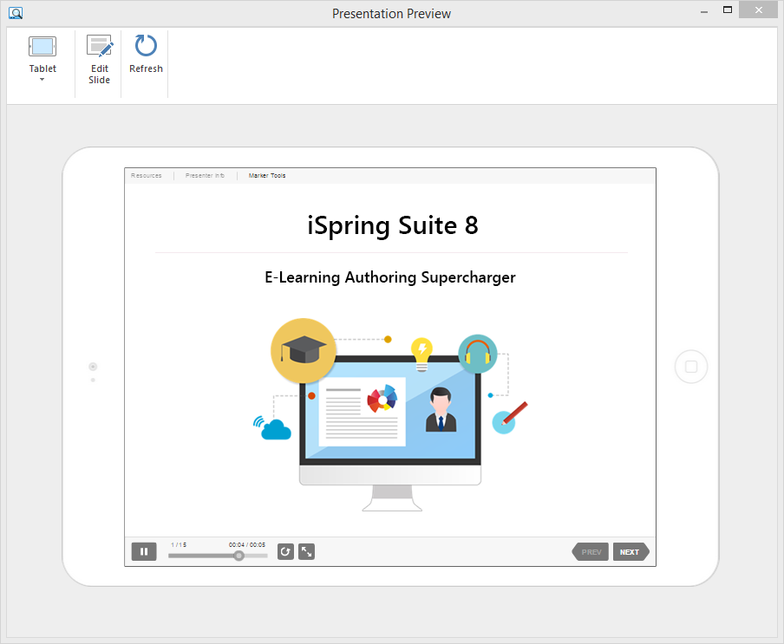
Use the Multi-Device Preview Option
13
iSpring’s preview mode allows you to see exactly how your course will look on different devices:
Desktops
Tablets
Smartphones

Slide 16




Would you like to learn more?
Check out iSpring’s helpful resources.
Video Tutorials
Community
Knowledge Base
Have a great time with

